Slide 1
Logos can be for many things

Slide 2
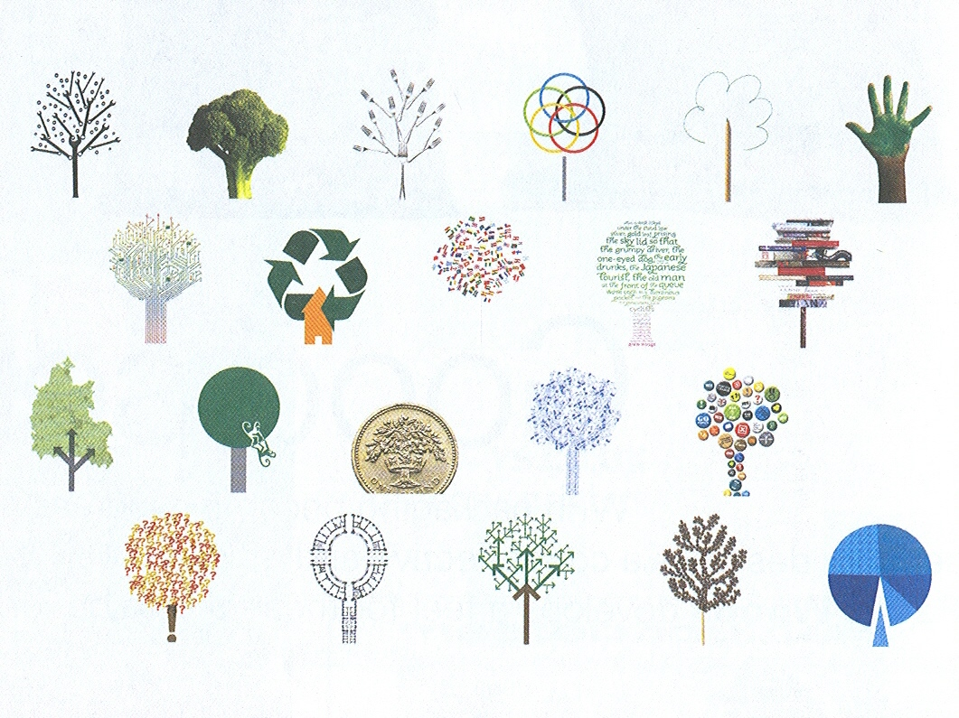
Hoarding for Oxford Brookes University by Hat-Trick Design

