Slide 1
Games Designer
Architect
Cartoonist
Jobs in Design
Interior Designer
Animator
Tattoo artist
Film Director
Graphic designer

Slide 2
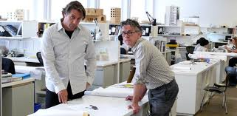
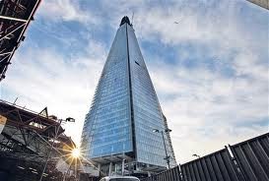
Architect
Qualifications- To become an architects firstly you will need a good range of GCSE’s including Maths and English and preferably a range of GCSE’s in arts or science’s. The requirements at A level vary usually needing two A levels in an academic subject along with two AS levels however this varies. After that you will need to study and pass a degree, validated by The Royal Institute of British Architects and at a recognised School of Architecture. To be become a fully qualified architect it usually takes around 7 years.
Salary- Architects usually earn a reasonable amount when starting out around £35000-45000 however once you have become established the salary can grow though.
Job description- Architects are involved in the earliest stages of building development by coming up with initial designs, establishing budgets and accessing it’s needs and impacts. They also work closely with contractors to make sure the work is carried out to a specific quality. Most of their main responsibility's are proposing ideas, setting budgets, creating drawings of the projects and regular site visits among other responsibilities.
Career Prospects- In architecture there is no set career structure due to the fact that it depends on the actual architects experience, competence and their firm however in larger firms there is more chance to move through the company and further their campaign. Afterwards a considerable amount of architect with experience set up their own firms.

Slide 3
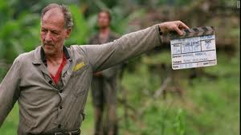
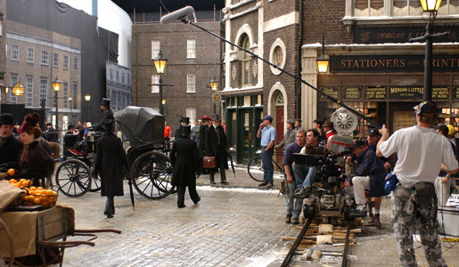
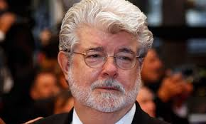
Film Director
Qualifications- Whilst there are many formal and recognised film courses you can take, a formal qualification is not necessary where as gaining experince in the area is extremely important as most film directors work there way up from the bottom.
Salary- A starting salary can range from £18,000 to £25,000 and with more experience can rise to £20,000 to £35,000 and with lots of experience can go up to £35,000 up to £70,000+.
Job description- A film director is the main creative force in a films production and are mostly responsible for translating the written script into reality making the director have to visualise the story and bring it together as a team leader. Directors' main duties include casting, script editing, shot composition, shot selection and editing.
Career Prospect- During a career like this it is normal to begin as a runner or trainee and then work your way up however companies such as the BBC have structured career paths. Free lance directors though usually take a path of progressing from smaller projects such as student films ETC to bigger and more prestigious projects making their way up.

Slide 4
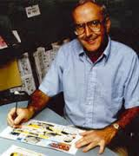
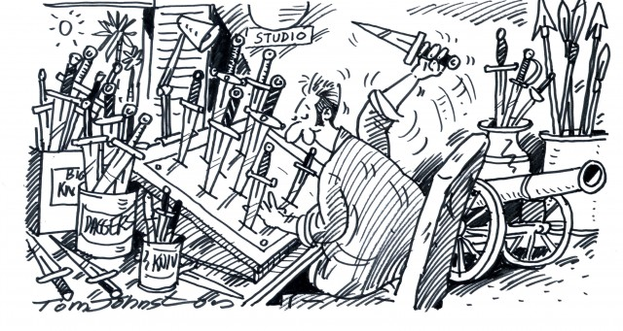
Cartoonist
Qualifications- To become a cartoonist you will obviously need skills in design, art and drawing as well as 5 A*-C at GCSE including maths and English and three A levels to be accepted into taking a cartoon course at college/university.
Salary- starting salaries are usually around £12,000-£20,000 and can raise to around £30,000 with more experience.
Job description- Usually cartoonist’s draw single pain drawing’s to be used in magazines, graphic novels, news papers and even video games. Most cartoonists are self employed so must devote a lot of time to building their following and promoting their work. Most cartoonists have a website where they respond to fan comments and offer cartoon-related merchandise to fans to build their followers.
Career Prospect- At the moment there are growing opportunities for cartoonists in online media, electronic magazines and magazines. The opportunities for cartoonists increase as the cartoonist becomes more well known and their fan base increasing

Slide 5
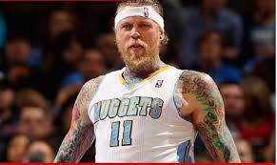
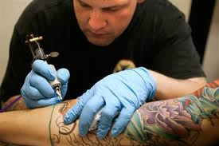
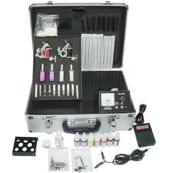
Tattoo Artist
Qualifications- There are no official requirements to become a tattoo artist however usually a range of GCSE’s are recommended and a keen sense of design is needed, as well as having good knowledge of health and safety. Most Tattooist’s start out by getting apprenticeships with a local tattooist to become fully competent and it can last from 1 to 3 years.
Salary- Tattooist's usually earn around £15000 however it can vary depending on skill and those owning their own studio varies widely.
Job description- A tattooists jobs revolve around advising clients on suitable tattoos, making sure that the chosen design is exactly what the client wants and placing the chosen design onto the customer’s skin, either by drawing freehand or using a transfer following the lines with an electrically-operated needle, which injects ink under the skin using different shapes and numbers of needles depending on the type of tattoo. Aswell Tattooists most follow strict hygiene and health and safety procedures.
Career Prospect- After years of gaining experience and work a tattoo artist would eventually be able to open their own studio and become self employed. This would mean they could chose their working hours and salary depending on their success.

Slide 6
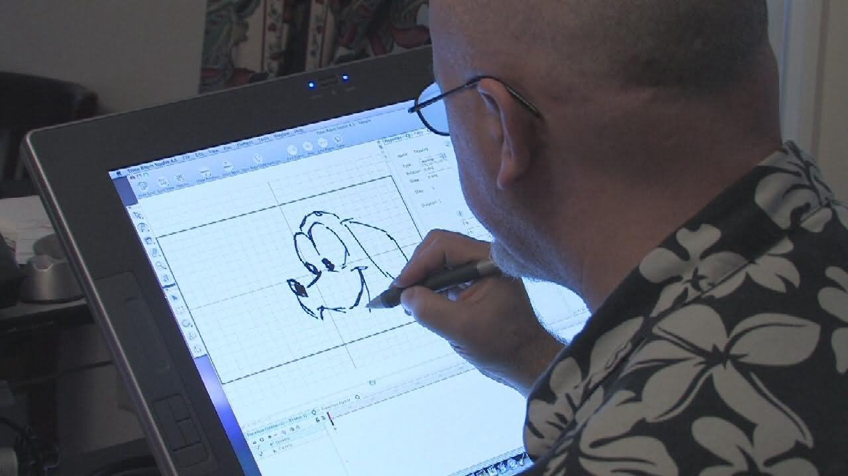
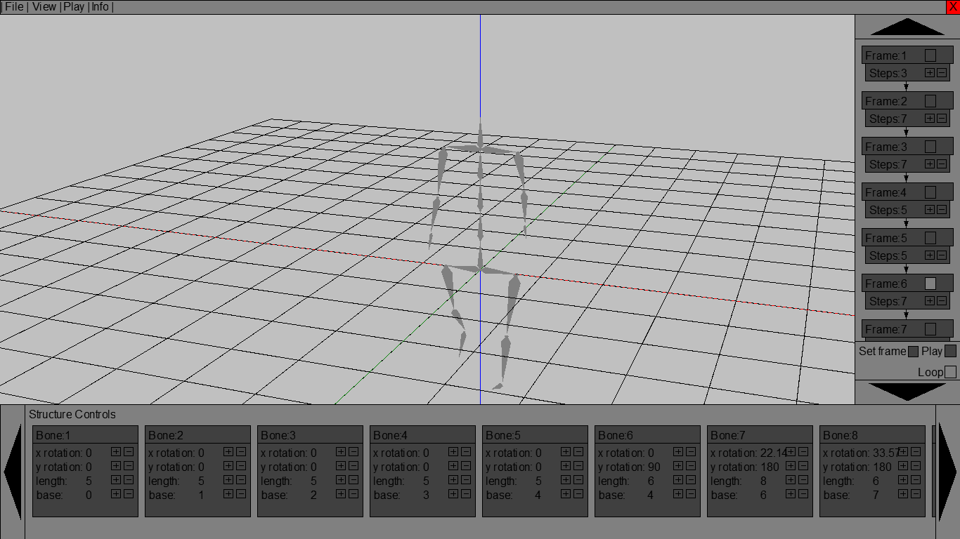
Animator
Qualifications- The area of work is open to all however it is rare to enter in to it without some form of higher qualification (preferably a foundation degree or degree) which can include animation, graphic design/illustration, 3D design, art and design, model making or sculpture design ETC. However exceptions can be made for very talented candidates.
Salary- An entry salary for an animator is usually around the mark of £12000-£15000 though salaries in computer games start higher at £18,000, rising quickly with experience. With experience a animator can expect to earn around the mark of £23000-£25000 and after 10 years of experience a animator can expect to earn from £26000 or more.
Job description- Animators tend to work in 2D animation, 3D model-making animation, stop frame or computer-generated animation. Computer-generated animation features strongly in motion pictures, as well as in aspects of television work, the internet and the computer games industry. Usually an animators job revolves around the animator creating storyboards to depict a script, drawing sketches/artwork, designing models, sets, characters ETC. After this sought of preparation the animator goes onto using software packages to make frame to frame visuals and also making sure it meets the requirements of the audio soundtrack
Career Prospect- Most animators begin as studio runners and then progress to junior animation roles. In 2D animation, you may begin work as an 'inbetweener', then progress to key framer. 3D animation has a more hierarchical structure, starting as a junior animator, with progression to senior animator after a few years' experience and finally design manager or art director. Senior roles involve more paperwork, managing staff and generating new ideas. Career progression mostly takes place through freelance work

Slide 7
Private Company Organisation Plan: Ian Simpson Architecture
Ian Simpson (Director)- Leads and manages functions within the company by strategizing plan and is overall in charge of the companies functions.
Nick Flemming (Associate Director)- Under administrative direction, plans, organizes, and directs the day-to-day operations of a department.
Alastair Keyte (Project Director)- responsible for overseeing development, implementation and creation on a project.
Marhami Arifin (Project Architect)- The senior team member responsible for the overall development and implementation of a specific architectural project-
Silvia Filucchi (Architect)- Takes on the role of designing buildings.
Jessie Hu (Architectural Assistant)- Support and assist architectural teams.
Kristin Mishra (Model Maker)- Makes 3D models to show what buildings or products will look like as well to test new designs.
Sakis Kyratzis (Graphic Designer)-Responsible for creating design solutions that have a high visual impact for a range products
Jordanne Byrne (Receptionist)- Makes first contact with clients and records details and helps sought out organisation.
Joanne Ormerod (PA to Directors)- Provides support to directors.

Slide 8
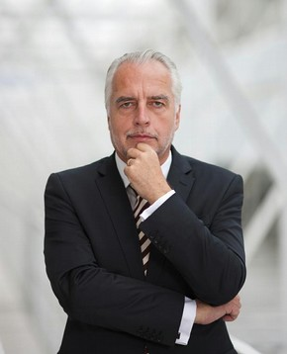
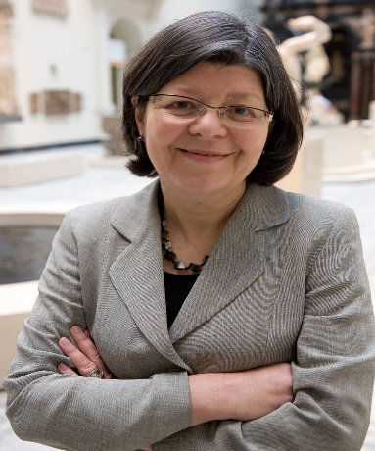
Public Institution Organisation Plan: The Victoria Albert Museum
Martin Roth, Director- takes on the role of generally leading the organisation by maintaining relationships with stakeholders (Department for Culture, Media and sport)and managing the business of V&A’s Board of Trustees. As well he takes on the role of corporate planning and performance reporting.
Beth McKillop, Deputy Director- The Deputy director has a similar job to the Director by coming up with stratergies but provides closer leadership with staff and over sees development in the organisation
Departments-
Estate Department
The Estate department is responsible for the continuing maintenance and repair of building fabric and services across the V&A Estate.
Exhibitions Department
The Exhibitions Department manages a diverse programme of temporary exhibitions.
Development Department
The Development department raises money for the V&A
Conservation Department
The Conservation Department is responsible for the preservation, conservation, investigation and display of the Victoria and Albert Museum's collections
Asian Department
The collections of the Asian Department cover a period of more than 5000 years, from 3,500 BC to the present day
Learning Department
The Learning Department is responsible for developing and delivering learning programmes

Slide 9
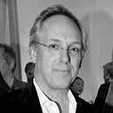
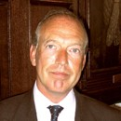
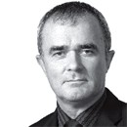
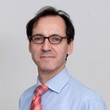
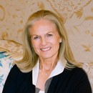
Board of Trustees
The V&A is governed by a board of Trustees as it is a public institution and trustees are appointed by the Prime Minister. Trustees are appointed in the first instance for a term of up to five years and may be re-appointed at the end of their term.
Sir Paul Ruddock
Samir Shah
Andrew Hochhauser
Stephen McGuckin
Michelle Ogundehin
Sir John Sorrell
Bob Stefanowski
Dr Paul Thompson
João Baptista
Dame Theresa Sackler

