Slide 1
The Starter
Your Response
Start to think about the building
To get you to identify elements you can use for your designing
Once complete, continue work on assignments

Slide 2
Lesson Objectives
Objectives - Coursework
- To further develop concepts with relation to idea generation
Objectives - Exercise
Start to understand the meaning of buildings
Identify elements to help design

Slide 4
St. Pancras Station, London

Slide 5
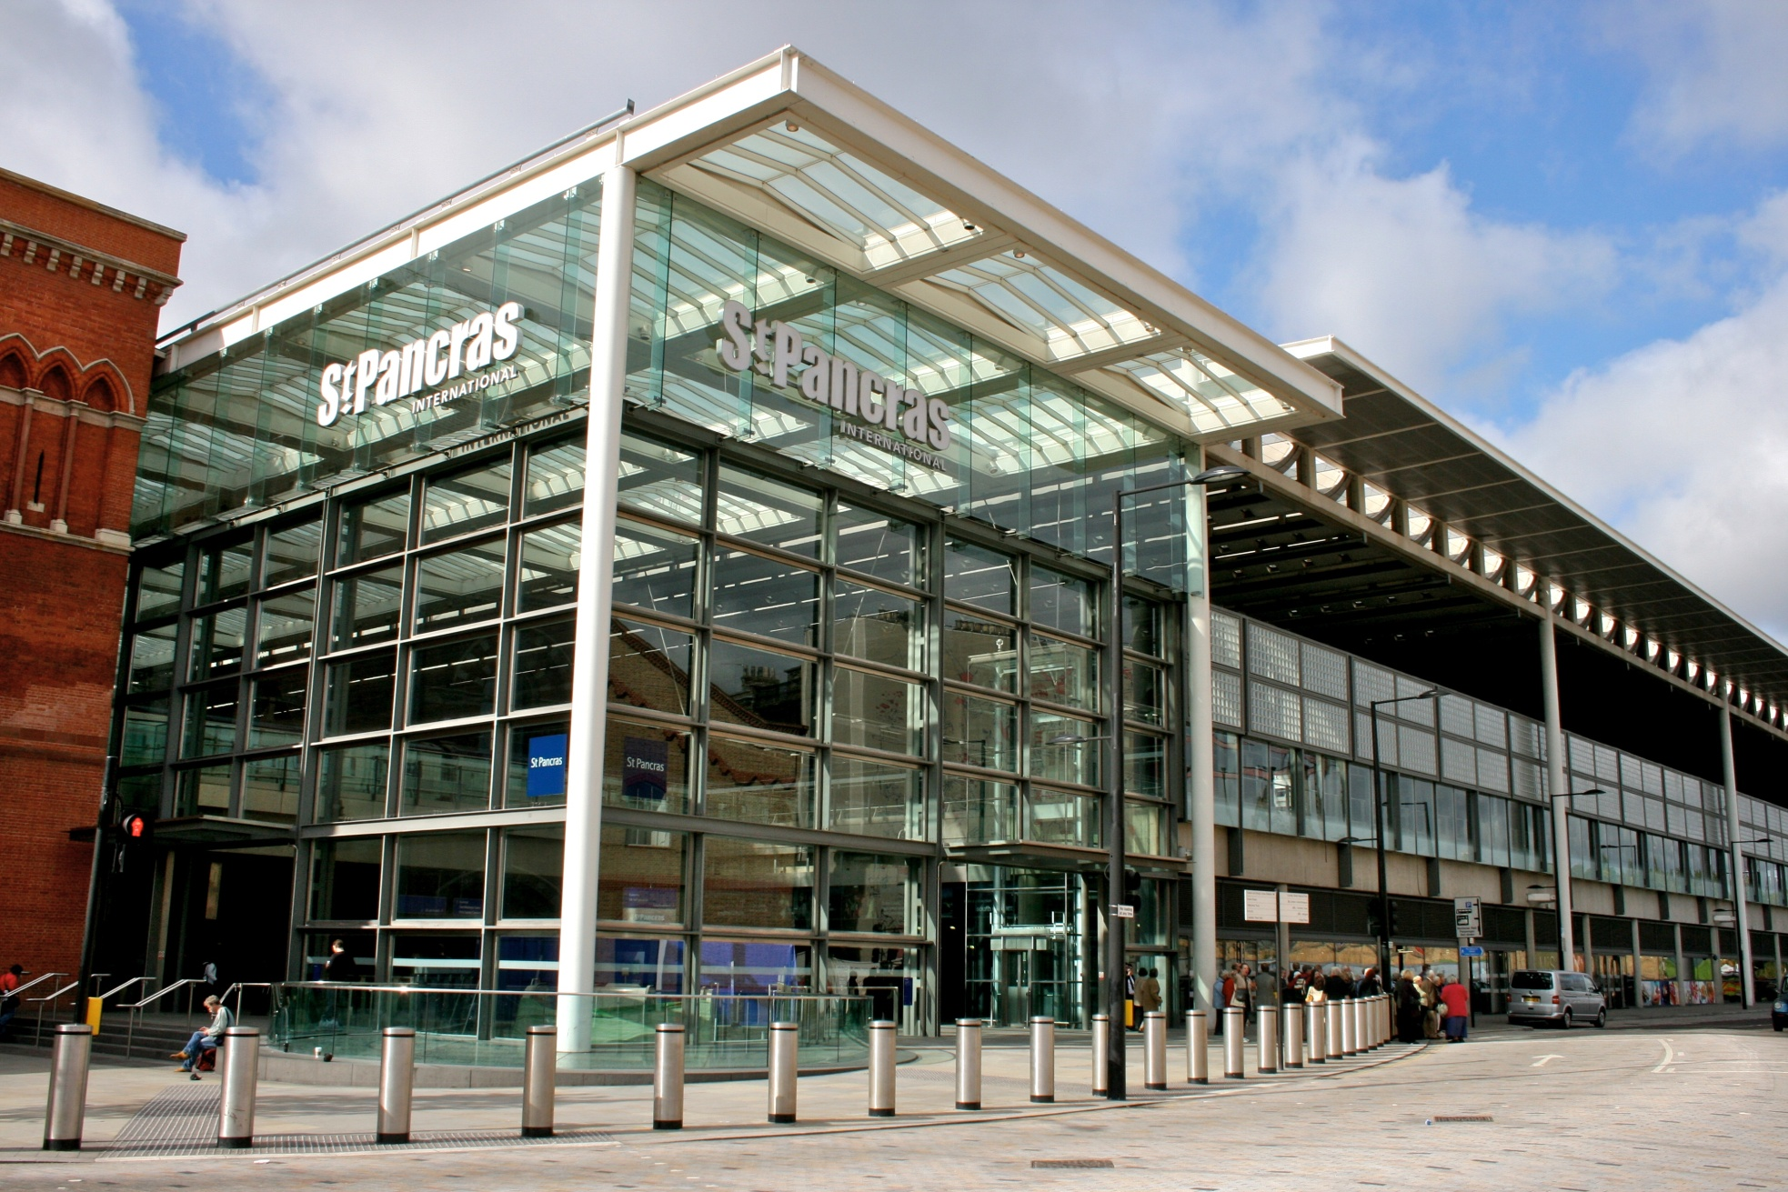

Slide 6
St. Pancras Station, London

Slide 7
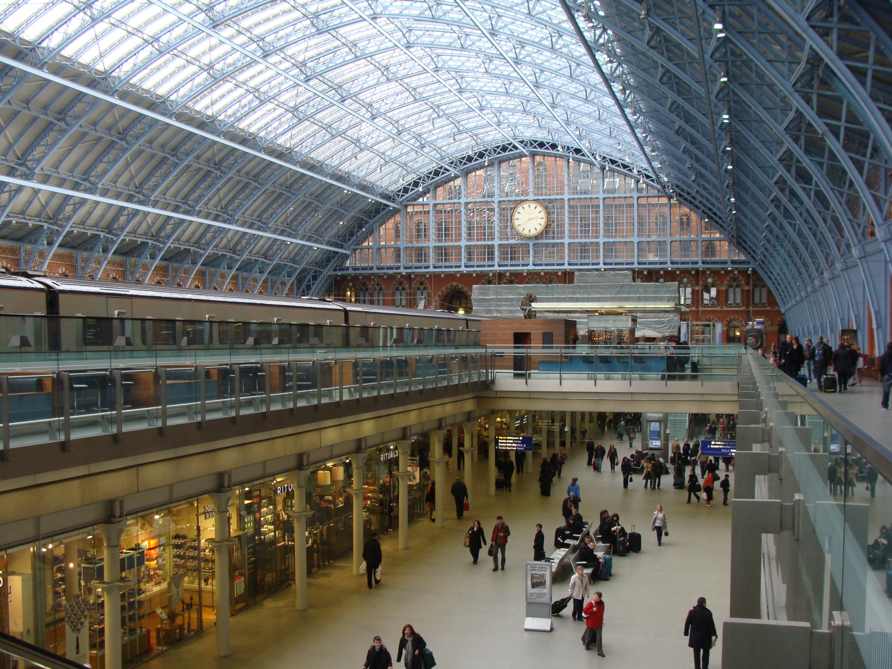

Slide 8
St. Pancras Station, London

Slide 9
Features
Glass roof to let light in
Blue to lighten it up
Open up basement
Creating shopping area
Using Art to enhance messages
Imposing Front
Location on tube hub
Creating new use
Modern extension
Enhancing the old features by cleaning
Mixing old with new

