Slide 1
The Starter
Your Response
Start to think about the building
To get you to identify elements you can use for your designing

Slide 2
Lesson Objectives
Objectives - Coursework
- To further develop concepts with relation to idea generation
Objectives - Exercise
Start to understand the meaning of buildings
Identify elements to help design
Objectives – Presentation
- To share information on design

Slide 3
Commonwealth Institute, London

Slide 4
The Commonwealth Institute opened in 1962

Slide 5
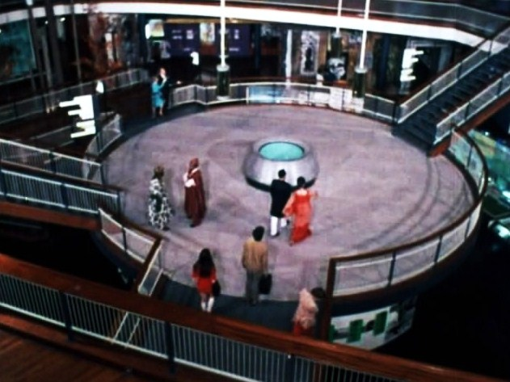
It celebrated the nations of the Commonwealth, their culture and life

Slide 6
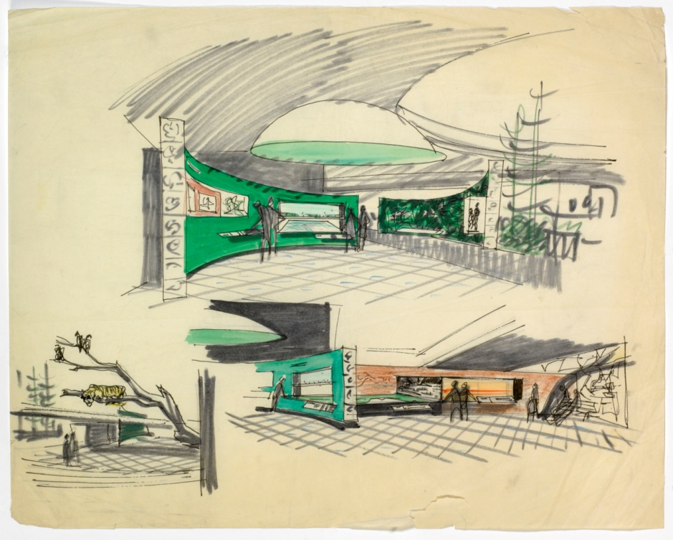

Slide 10
It celebrated the nations of the Commonwealth, their culture and life

Slide 11
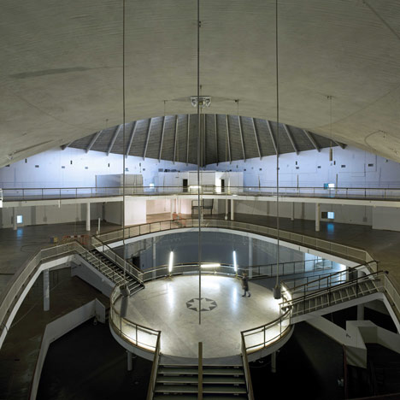

Slide 14
/
Closed 2002

Slide 15
Regarded by English Heritage as the second most important modern building in London, after the Royal Festival Hall, the building has a low brickwork plinth clad in blue-grey glazing. Above this swoops the most striking feature of the building, the complex hyperbolic paraboloid copper roof, made with 25 tonnes of copper donated by the Northern Rhodesia Chamber of Mines. The shape of the roof reflects the architects' desire to create a "tent in the park".

Slide 16
In January 2012 it was confirmed that the Design Museum would move to the building with an £80m makeover opening in 2014, now 2016

Slide 23
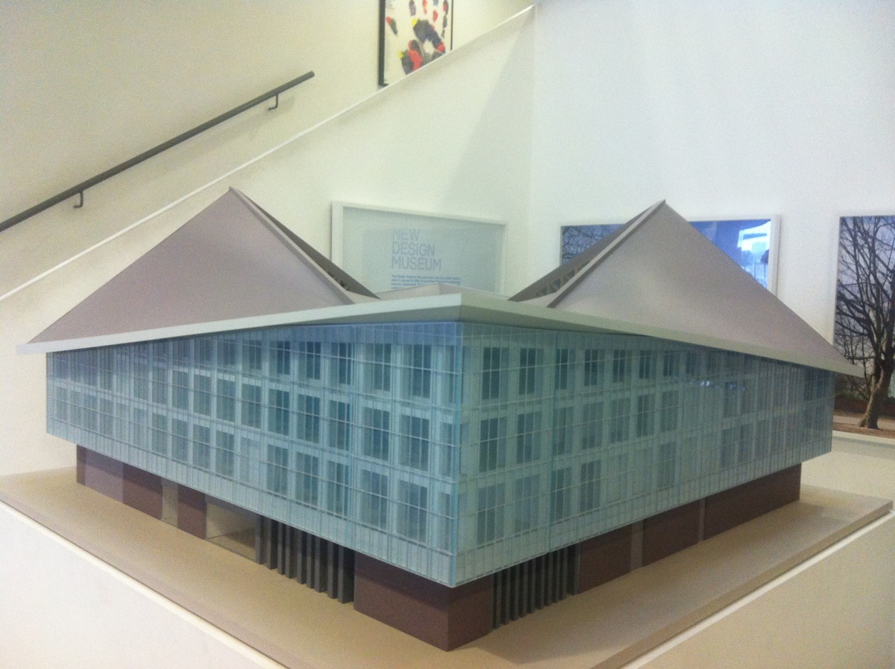

Slide 24
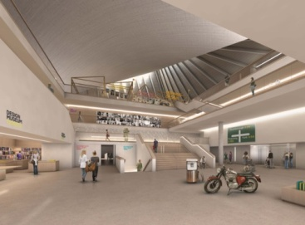
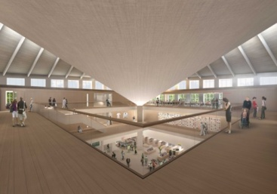

Slide 25
Features
Reusing an existing building for a new purpose
Open area with galleries around
Use the openness concept
Evolve ideas, using computing models and models

