Slide 1
Lesson
Starter Task
Do initial worksheet on Imperial War Museum North whilst you are loading up

Slide 2
Lesson Objectives
Objectives - Exercise
Start to understand the meaning of buildings
Identify elements to help design

Slide 3
The Starter
Your Response
Start to think about buildings
To get you to identify elements you can use for your designing

Slide 4
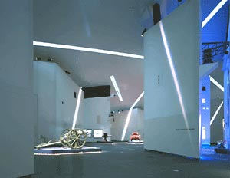

Slide 5
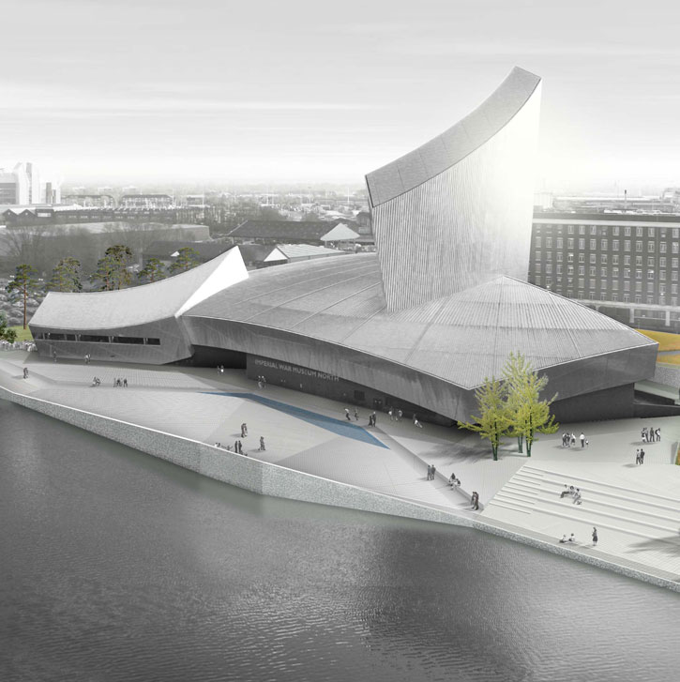

Slide 6
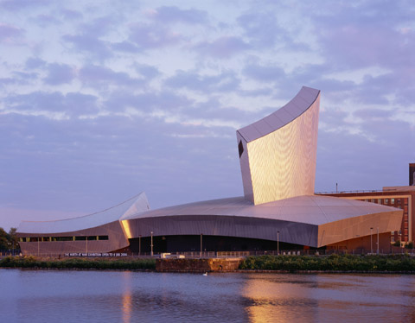

Slide 7
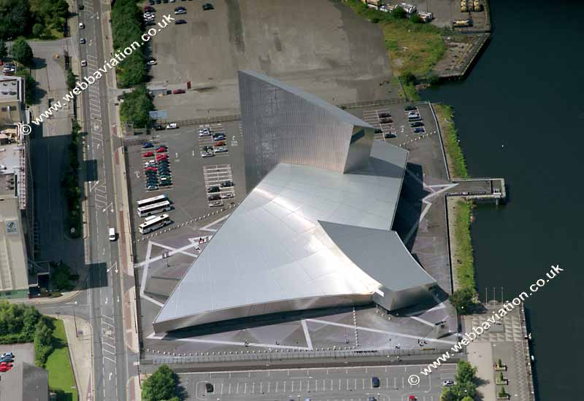
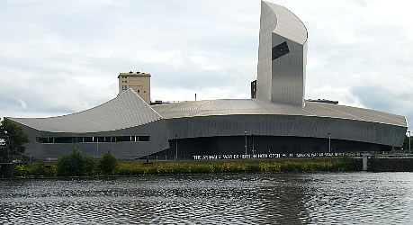

Slide 8
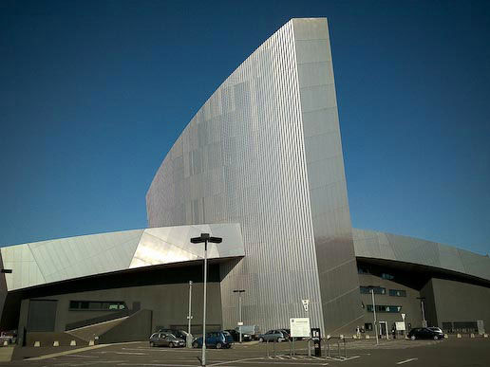

Slide 9
