Slide 1
The Starter
Your Response
Start to think about the building
To get you to identify elements you can use for your designing

Slide 2
Lesson Objectives
Objectives - Coursework
- To further develop concepts with relation to idea generation
Objectives - Exercise
Start to understand the meaning of buildings
Identify elements to help design
Objectives – Presentation
- To share information on design

Slide 3
London Bridge Station, London

Slide 8
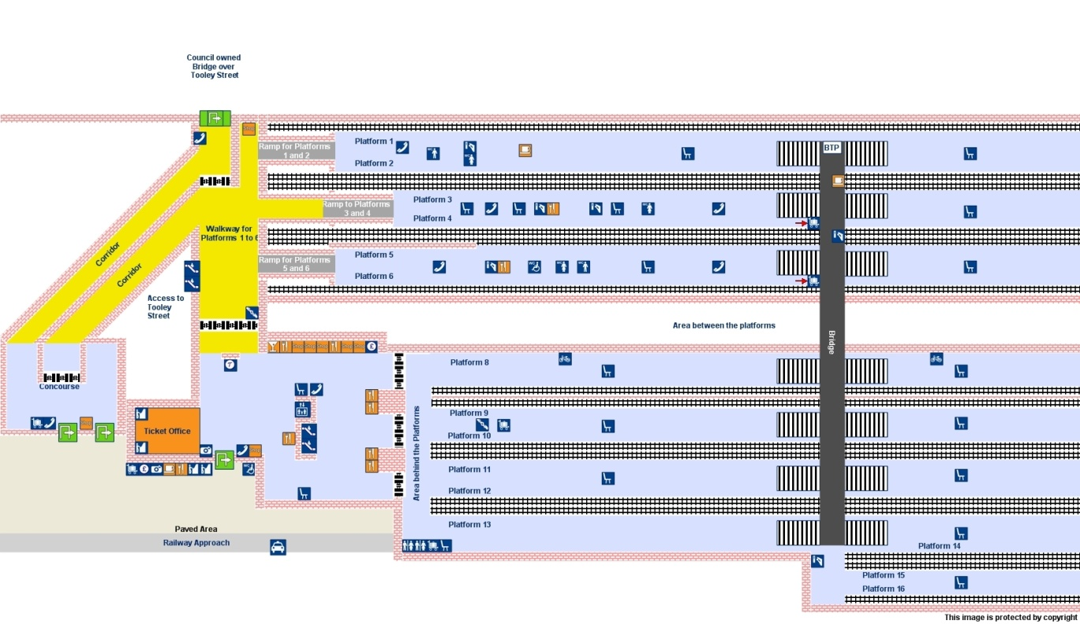

Slide 13
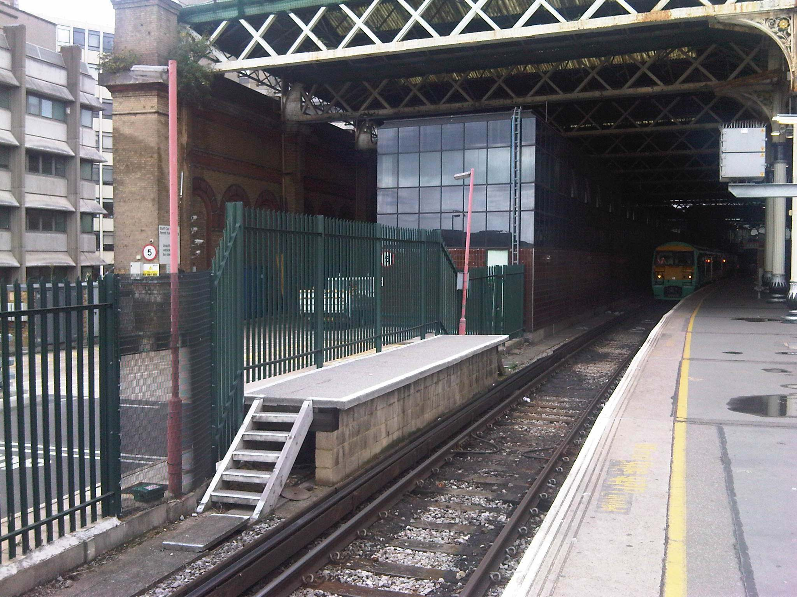

Slide 14
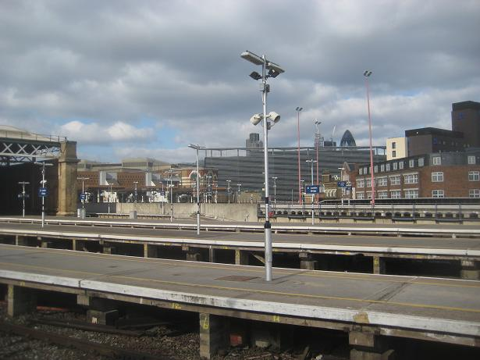

Slide 15
The Proposal
Built in 1836 – 179Yrs ago
117 million pass through – 54m start here
Cost £400m
Full start 2013
Complete 2018 - you will be in yr. 13

Slide 18
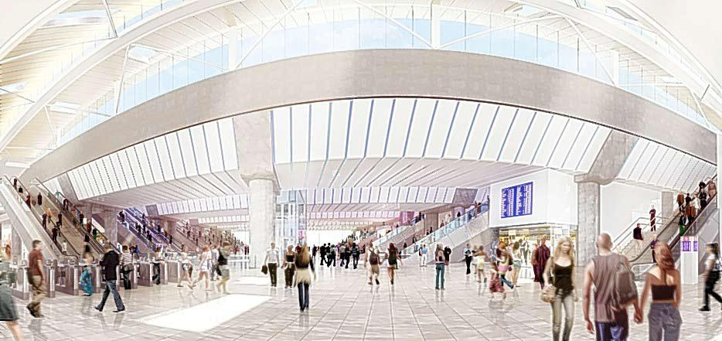

Slide 19
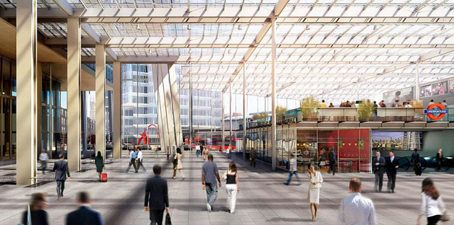

Slide 25
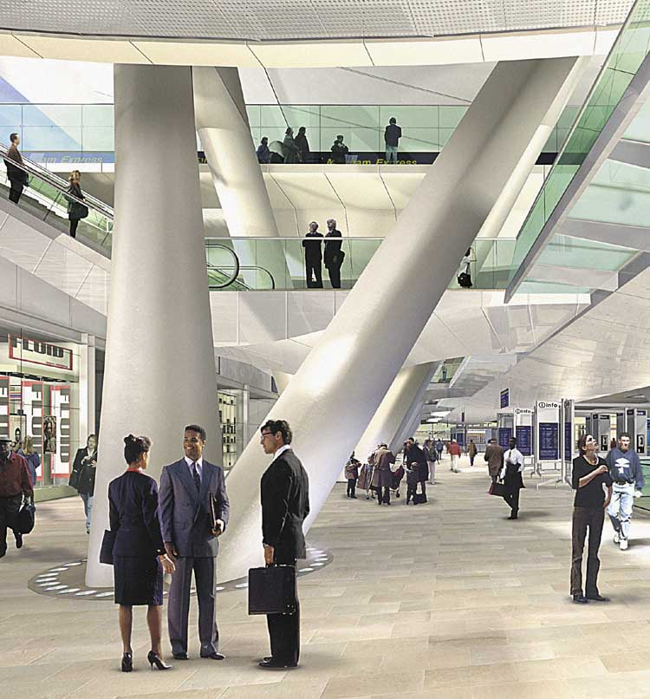

Slide 26
Features Old New
1.

