Slide 1
Assignment 1 Shop Front Project

Slide 2
Stage 1 - Investigation

Slide 4
Stage 2 - Design

Slide 5
Stage 3 - Development

Slide 6
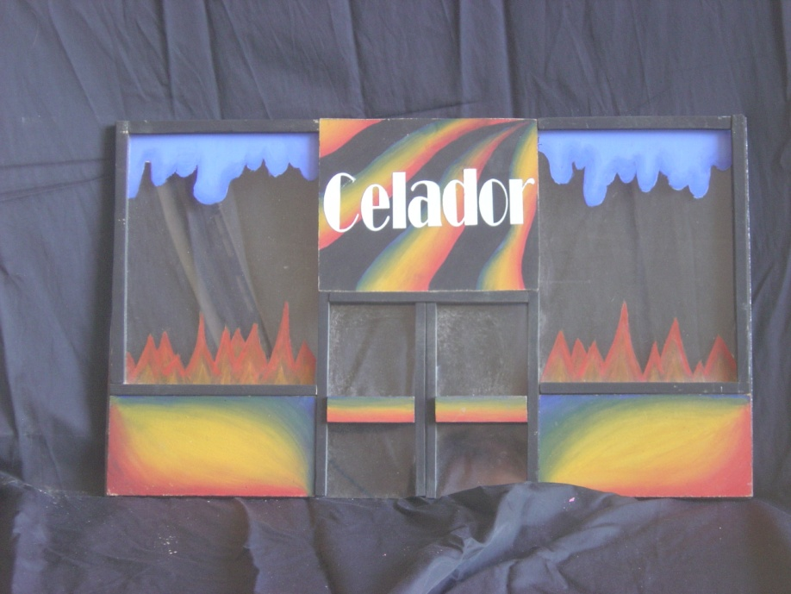
Stage 4 - Manufacture

Slide 7
