Slide 1
British Museum, London

Slide 2
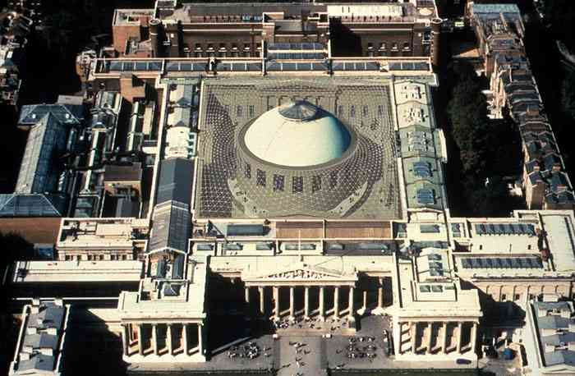

Slide 4
Neo Classical Style
From the architecture of Classical Greece and Rome
Starts around earlier 18th century,
Planner features
Columns
Framed reliefs

Slide 5
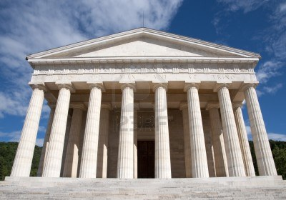
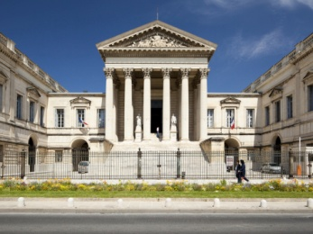
Neo Classical
Canova Temple, Italy
Palais De Justice, Montpellier, France
US Supreme Court, Washington DC.

Slide 6
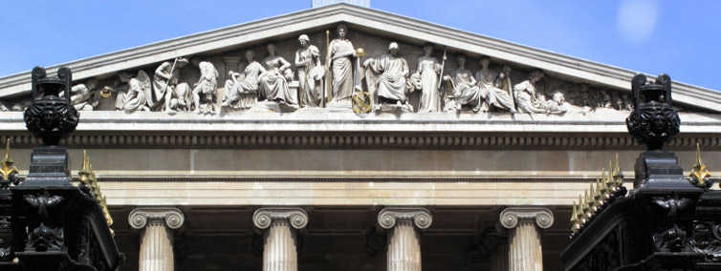

Slide 7
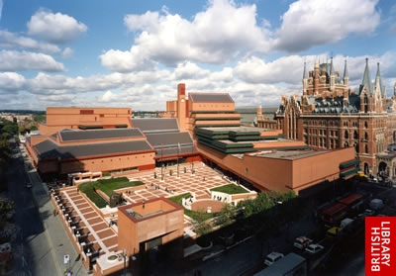
Established 1753
Opened 1827
Opened to the Public - 1857
Architect –Sir Robert Smirks
The Great Court
Opened 2000
After books moved to the
British Library

Slide 10
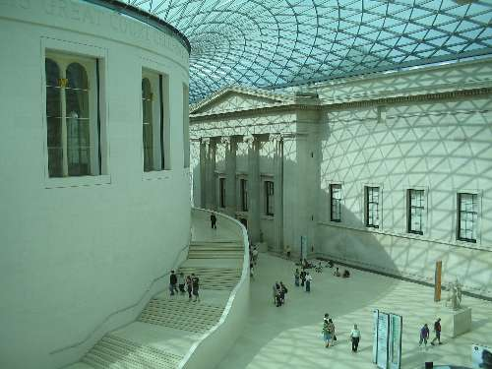

Slide 14
Features
Mixing old with new
Reusing areas for new projects
Using new materials to create new area
Taking a concept and adapting to our environment

